Slide 1
Chapter 14 - Part II
Decision Trees
Athena Alimirzaei
Department of Management
College of Business

Slide 2
5. Decision Trees
Recall that the decision-making environments can be classified as follows:
  (1) Decision-making under certainty (DMUC) - Two or more states of nature exist, and it is known which of them will occur for sure.
  (2) Decision-making under uncertainty (DMUU) - Two or more states of nature exist, and it is unknown which of them will occur.
  ● Non-probabilistic case - Maxi-max, maxi-min, and mini-max regret.
  ● Probabilistic case - MO, EV, ER, and EVPI.
Another key analytic tool falling under DMUU - Probabilistic case is the decision tree.
2

Slide 3
5. Decision Trees
Major components of a decision tree:
  Decision node () - A point where various alternatives (or actions or decisions) are available.
  Event node (Ο) - A point where various states of nature can occur according to a probability distribution.
  Branch (-) - An alternative if emanating from a decision node () or a state of nature if emanating from an event node (Ο).
  Terminal node (|) - A point which signals the completion of the decision-making process.
Remark: The leftmost decision node is called the root of the decision tree.
Notes:
Today, auctions have been used to conduct a huge volume of transactions, such as the sale of houses, cars, private collection and government project. Auctions have experienced exponential growth in terms of sales volume, revenue, and product categories. In addition, New auctions continue to be designed and implemented.

Slide 4
5. Decision Trees
A decision tree is constructed from the left to the right (i.e., a forward pass), but it is analyzed from the right to the left (i.e., a backward pass).
Remark: Throughout this chapter, we will follow the so-called settle-up-at-termination convention in constructing a decision tree. This means that all the intermediate payoffs along the path from the root of the tree to a terminal note are taken into account and the net payoffs will be shown to the right of the terminal node.
Analysis of a decision tree consisting of performing two tasks:
  (1) At an event node (Ο) - Compute the EP over all states of nature.
  (2) At a decision node () - Select the best alternative (i.e., make the best decision).

Slide 5

5. Decision Trees
Example 14.6: Allen must decide whether to invest $10,000 in the stock market or in a six-month certificate of deposit at an interest rate of 8.5 percent. If he invests in the stock market and the market is good, he gets a 14% return on his money. If the market is fair, he gets an 8% return. If the market is bad, he gets no return at all.
Suppose that the probabilities of a good market, a fair market, and a bad market are 0.4, 0.4, and 0.2, respectively. What should Allen do based on a decision tree analysis?
[Solution] We see from the following decision
tree that Allen should invest in the
SM. The maximum expected return
is $880.

Slide 6
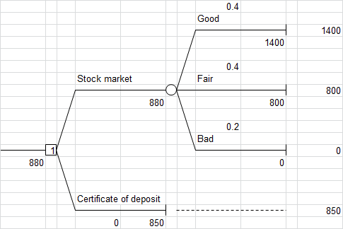
5. Decision Trees
Example 14.6: (cont’d)
[Solution]

Slide 7
5. Decision Trees
Example 14.7: A businessman decides to buy a computer to keep track of his billing, payroll, inventory, and client records. He needs a small system now, but growth of the business could make it inadequate in three years and a large system would be required in that case.
He narrows his choices down to buying a small system, a small system that can be expanded, or a large system at the respective prices of $4,000, $6,000, and $9,000. In three years, he can either trade in the small system for a large one at a cost of $7,500 or expand the expandable small system at a cost of $4,000.
Suppose that there is an 80% chance that the business will grow and a large computer system will be needed in three years. Perform a decision tree analysis to determine what the businessman should do to minimize his expected cost.

Slide 8

5. Decision Trees
Example 14.7: (cont’d)
[Solution] We see from the following decision tree
that a large computer system should be
purchased now. The minimum expected
cost is $9,000.

Slide 9
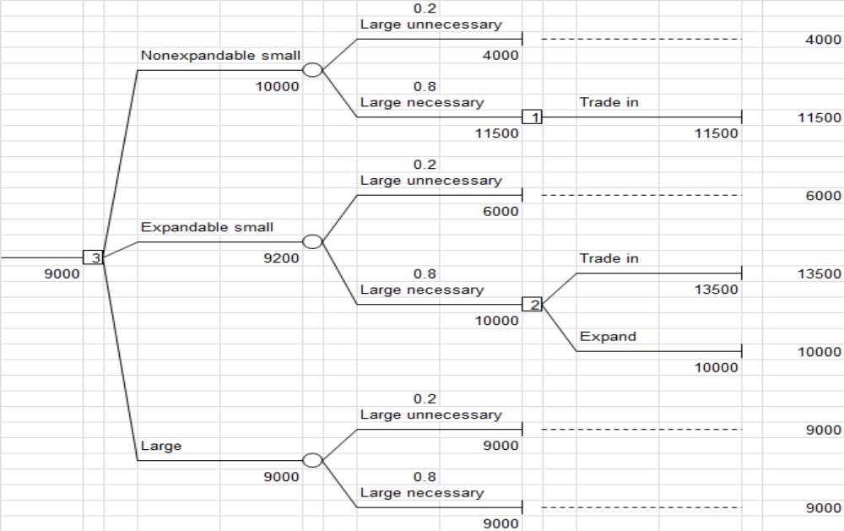
5. Decision Trees

Slide 10
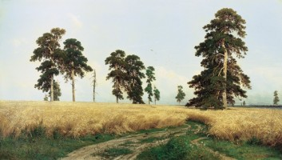
5. Decision Trees
Example 14.8: A client is willing to pay $50,000 to buy a famous painting. The art dealer can get the painting for her today for $43,000 or can wait a day and get the painting tomorrow for $30,000 if it has not been sold. The dealer may also wait another day and get the painting for $26,000 if it is still available. At the end of the third day, the painting will no longer be available. Each day, there is a 0.6 probability that the painting will be sold. Perform a decision tree analysis to determine what the dealer should do to maximize his expected profit.
[solution] It is seen from the decision tree below that
the art dealer should wait on Day 1. If the
painting is still available on Day 2, he
should buy it then. The maximum expected
profit is $8,000.

Slide 11
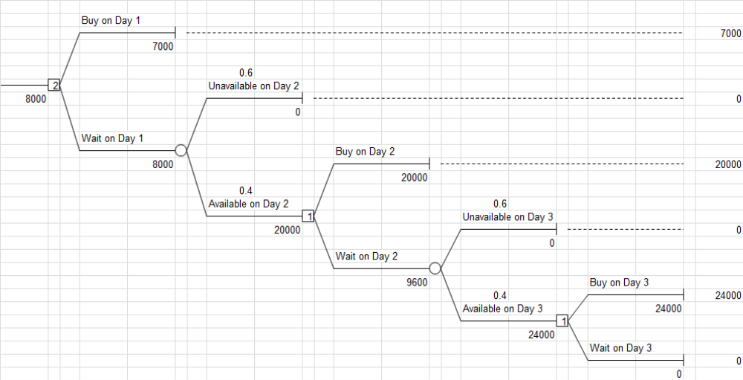
5. Decision Trees

Slide 12

5. Decision Trees
Example 14.9: A 66-year-old man with a hernia has two choices according to his doctor. If he chooses to wear a truss, there is a 97% chance for him to live another 8 years without the risk of strangulation. But there is a 3% chance of strangulation, which will occur in the middle of the 8-year span. In that case, an emergency operation is required with a 15% operative mortality.
If the elective surgery is chosen, however, he faces a
5% operative mortality with a loss of 8 years of life
and a 95% chance of surviving the operation and
living his remaining 8 years. Perform a decision tree
analysis to determine what the patient should do to
live as long as possible.

Slide 13
5. Decision Trees
Example 14.9: (cont’d)
[Solution] It is seen from the following decision tree that the patient should choose to wear a truss. In case strangulation occurs, he needs an emergency operation. His maximum expected remaining life is 7.982 years.

Slide 14
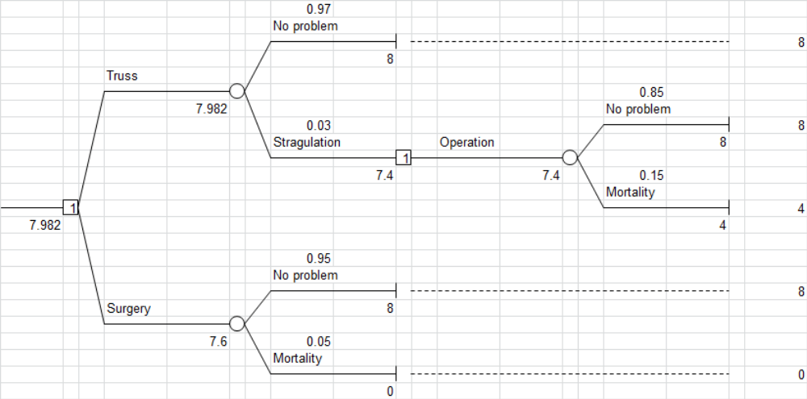
5. Decision Trees

Slide 15

5. Decision Trees
Example 14.10: A group of medical professionals is considering the construction of a medical clinic. If it is built and the demand for the medical services is high, the doctors could realize a net profit of $100,000. If the demand is low, however, they could lose $40,000. Of course, there will be no cost if they don't proceed to build the clinic. In the absence of any market data, the best they can guess is that there is a 50% chance that the demand will be high.
A local consulting firm offers to perform a study of the
medical market for the doctors at a fee of $5,000. It is
claimed that their experience enables them to make the
statements below:
(1) The probability of a positive result from the study is 0.55.
(2) The probability of a negative result from the study is 0.45.

Slide 16
5. Decision Trees
Example 14.10: (cont’d)
(3) Given a positive result, the probability of a high medical demand is 0.82.
(4) Given a negative result, the probability of a high medical demand is 0.11.
Use a decision tree to analyze the problem for the medical doctors and advise them what to do.
[Solution] We see from the following decision tree that the doctors should hire the consultants to study the medical market. If the result is positive, they should construct the clinic. If the result is negative, however, the clinic should not be built. Their maximum expected profit is $36,140.

Slide 17
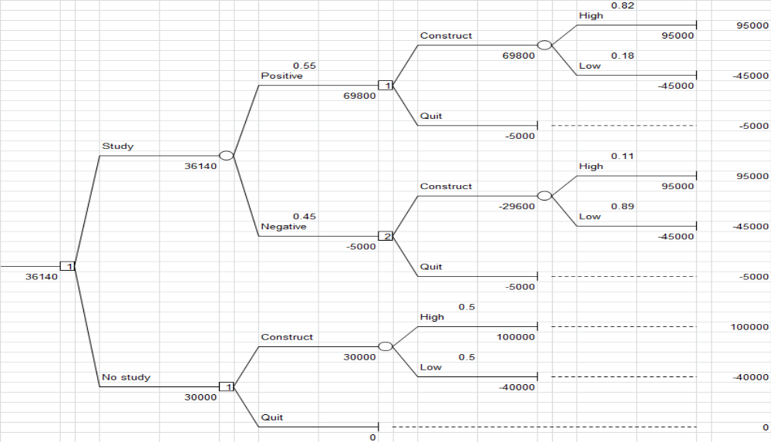
5. Decision Trees

Slide 18
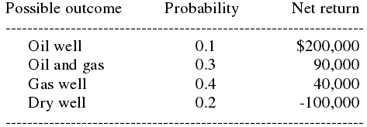

5. Decision Trees
Example 14.11: Fareast Oil Company (FOC) in Houston, TX, owns a piece of land of 100 acres west of Amarillo, TX. Desert Energy Corporation (DEC) has just offered $45,000 for the right to explore for oil there.
If FOC chooses to drill rather than sell the right, the results are uncertain. The possible outcomes, their probabilities of occurrence, and the associated returns are summarized below:

Slide 19
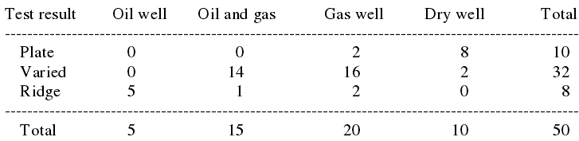
5. Decision Trees
Example 14.11: (cont’d)
FOC could pay a local consulting firm $6,000 to evaluate the formation of the terrain before making its final decision. The result should indicate which of the following three categories best describes the underground structure of the land: plate, varied, or ridge. The conditional probabilities of the possible outcomes for the last 50 tests follow:

Slide 20
5. Decision Trees
Example 14.11: (cont’d)
If the study is conducted by the consulting firm, then the opportunity to sell the right is forfeited because DEC will know that drilling does not appear to be profitable. Carry out a decision tree analysis of the problem for FOC to determine its optimal strategy and the maximum expected net profit.
[Solution] It is seen from the following decision tree that FOC should not sell the right to DEC. Instead, it should pay to perform the test. If the result is plate then it should not drill; otherwise, it should drill. The maximum expected net profit is $51,400.

Slide 21
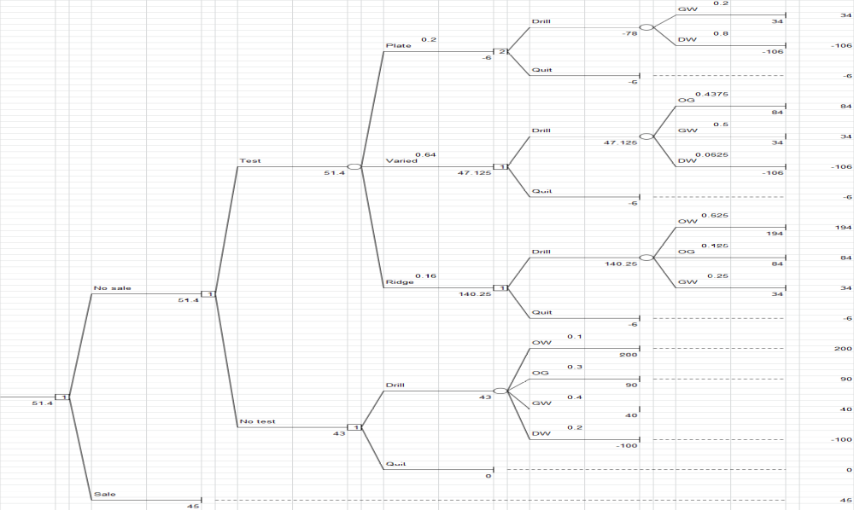
5. Decision Trees

